Slide 1
Customer Segmentation
Analysis
OASIS INFOBYTE - Data Analytics Internship | Level 1, Task 2
RFM feature engineering + K-Means clustering, validated with silhouette analysis
and one-way ANOVA not just a scatter plot with colors.
Prepared by: Minal Sadiq

Slide 2
Objective, Dataset & Approach
Objective
Segment an e-commerce customer base by purchasing behaviour so each group can receive a distinct, appropriate marketing strategy instead of one generic campaign.
Dataset
11,000+ raw transactions across 1,000 customers (2023-2024) order-level data with realistic messiness: cancellations, missing payment mode, duplicates.
Method
RFM (Recency, Frequency, Monetary) engineered from raw transactions -> K-Means clustering, with every choice (K, scaling) backed by a statistical check.
Tools
Python - pandas, scipy.stats, scikit-learn (StandardScaler, KMeans, PCA, silhouette), matplotlib, seaborn.

Slide 3
Step 1-2 - Cleaning & Building RFM
RFM was engineered from raw transactions inside the notebook, not handed to it pre-made
15 exact duplicate transactions found
Removed.
166 cancelled/returned orders (1.5%, negative value)
Excluded from Monetary a return isn't spend.
111 missing Payment_Mode values
Kept as explicit "Unknown" category.
Recency, Frequency, Monetary
Computed per customer relative to a fixed snapshot date (day after the last transaction).

Slide 4
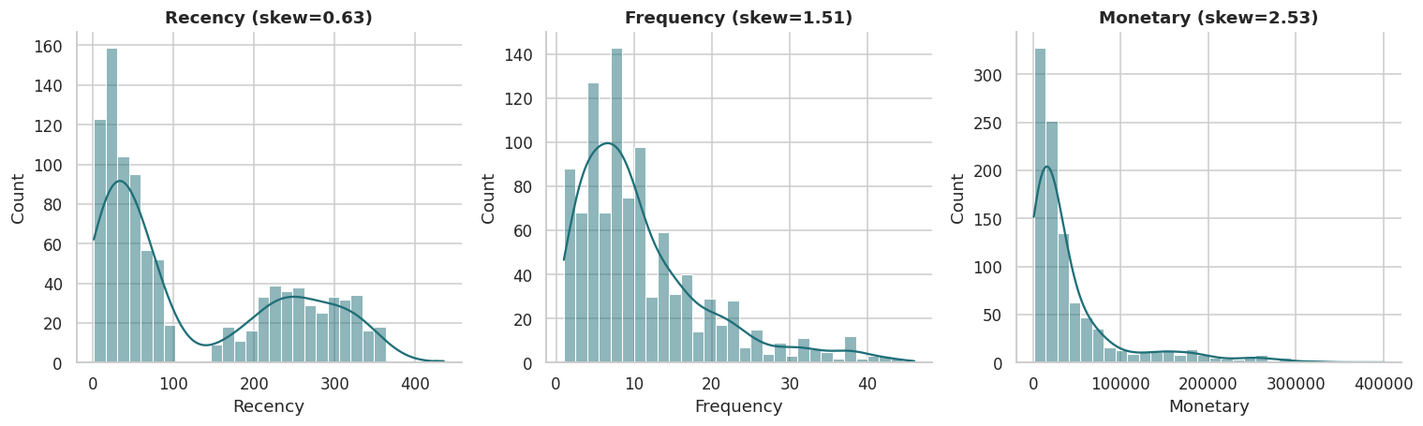
Step 3-4 - Descriptive Stats & Distribution Check
Average purchase value, purchase frequency, and lifetime-value view; then tested for normality
D'Agostino K² test: Recency p=2.0e-164, Frequency p=7.3e-60, Monetary p=4.2e-117
All three metrics: NOT normally distributed (p << 0.05)
Frequency and Monetary are strongly right-skewed a small group of very active, high-spend customers pulls the mean well above the median.

Slide 5
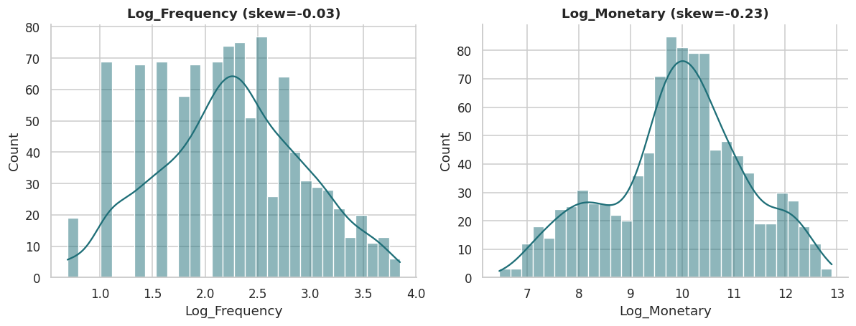
Step 5-6 - Log-Transform & Standardization
Correcting skew, then scaling so no single feature dominates the distance calculation
Why this matters: K-Means clusters on Euclidean distance. Without a log-transform, a handful of extreme high-spend customers would dominate the distance calculation. Without scaling, Monetary (thousands of Rs.) would swamp Recency (tens/hundreds of days) purely due to units.

Slide 6
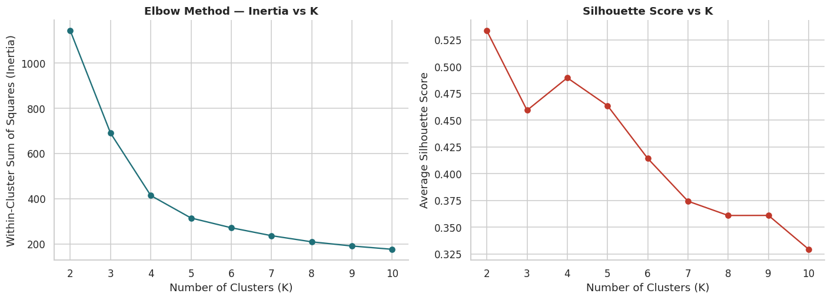
Step 7 - Choosing K: Elbow Method + Silhouette Score
Two independent methods, not a guess
Silhouette is mathematically highest at K=2 (a coarse "engaged vs disengaged" split) but K=5 is chosen: the elbow still bends around K=4-5, K=2 would be too coarse for distinct marketing actions, and Section 10's ANOVA independently confirms 5 groups are statistically real, not overfit noise.

Slide 7
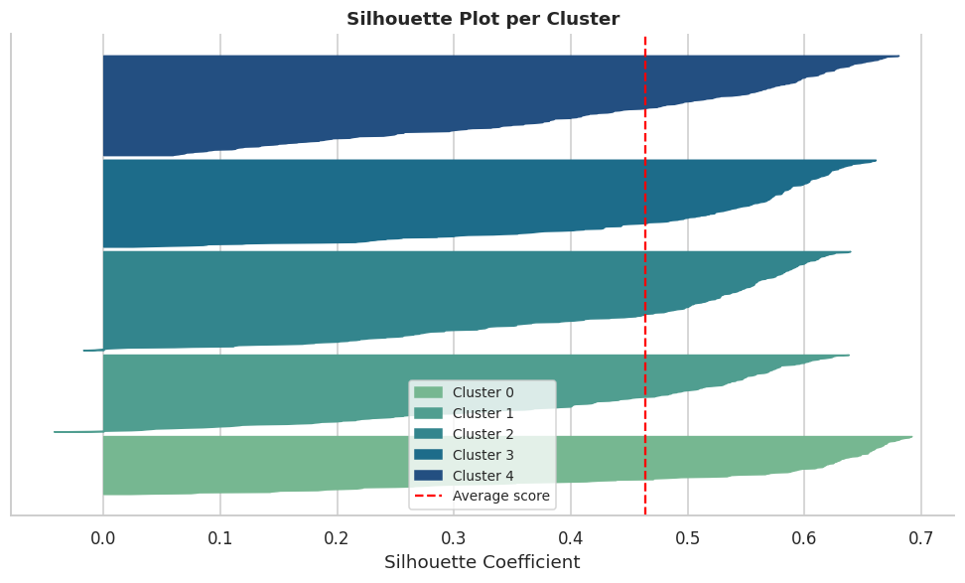
Step 8 - Final Model: K=5
Per-sample silhouette plot checks whether points are cleanly assigned, not just the average score
Silhouette score = 0.464. Most points sit comfortably above the average line with few negative values customers are mostly assigned to the right cluster, not ambiguously between two.

Slide 8
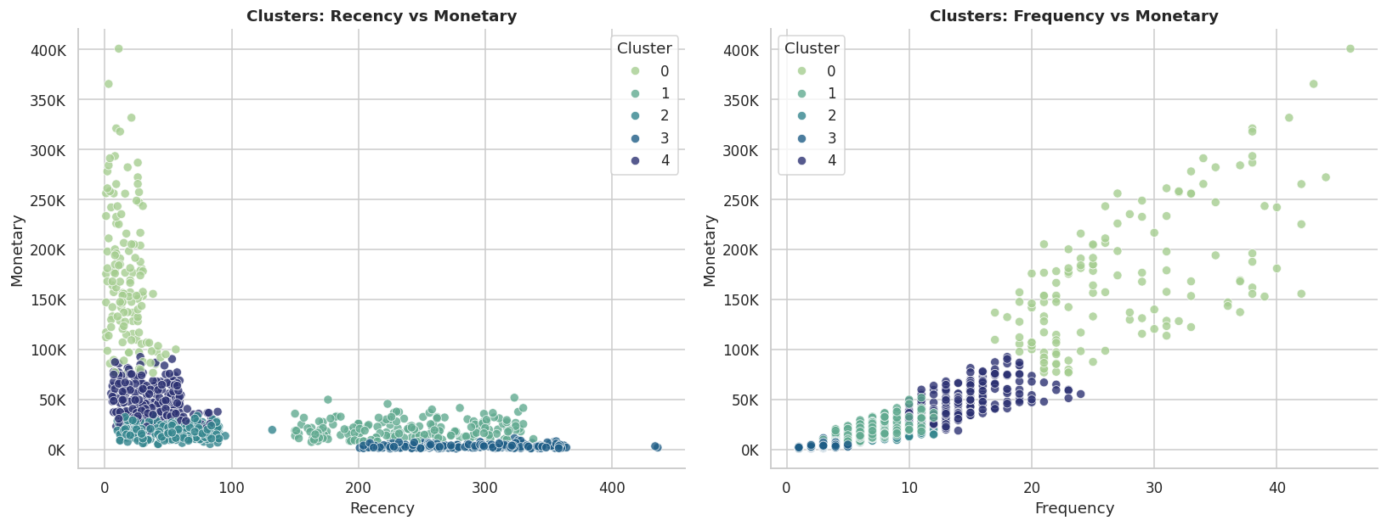
Step 9 - Cluster Visualization
Scatter plots on real RFM features, plus a PCA projection for an at-a-glance view
Clusters are visibly well-separated on both feature-pair views not an artefact of the algorithm forcing arbitrary splits.

Slide 9
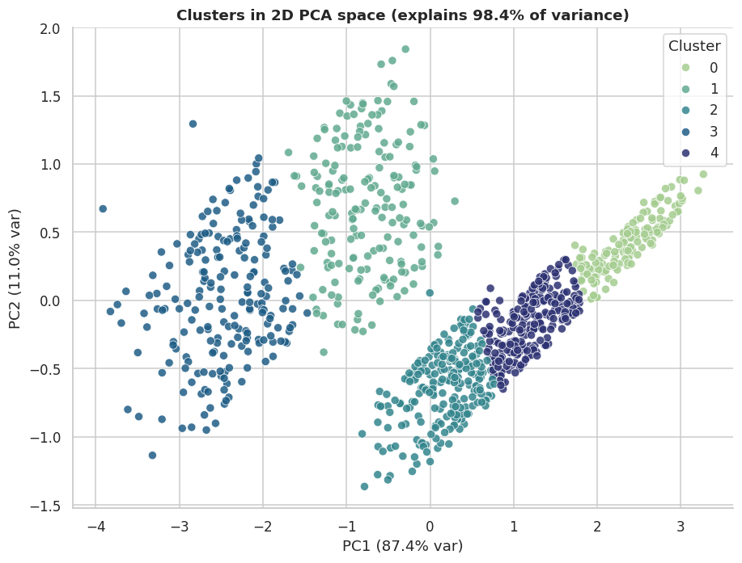
PCA Projection of the 5 Clusters
2 principal components capture 98.4% of total variance in the scaled RFM features

Slide 10
Step 10 - Statistical Validation (ANOVA)
Do R, F, and M genuinely differ across the 5 clusters, or could this be chance?
Metric
F-statistic
p-value
Verdict
Recency
2,472.30
< 0.001
Significant
Frequency
1,414.41
< 0.001
Significant
Monetary
1,005.67
< 0.001
Significant
Interpretation: all three RFM metrics differ significantly across clusters (p < 0.001 each) the segmentation reflects real, distinct customer behaviour, not random noise.

Slide 11
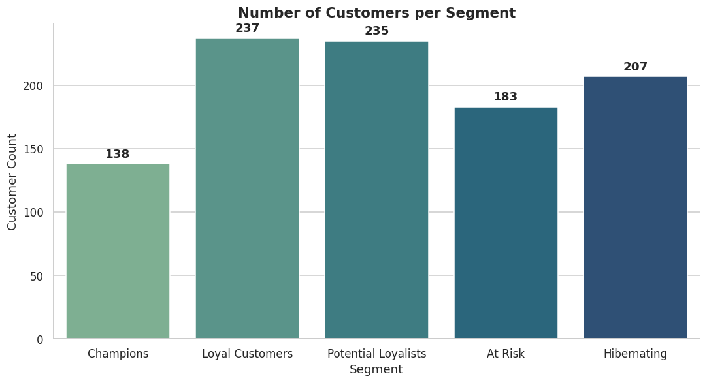
Step 11 - Final Segments
Names assigned programmatically by ranking each cluster's composite RFM score
Segment
Recency
Freq.
Monetary
% Base
Champions
~18d
~28
~Rs.170.6K
13.8%
Loyal Customers
~35d
~14
~Rs.48.5K
23.7%
Potential Loyalists
~54d
~8
~Rs.17.8K
23.5%
At Risk
~240d
~7
~Rs.20.2K
18.3%
Hibernating
~283d
~3
~Rs.3.3K
20.7%

Slide 12
Marketing Action per Segment
Champions
Reward with loyalty perks & early access; ask for reviews/referrals. Protect, don't over-discount.
Loyal Customers
Upsell/cross-sell; push toward Champion tier via a loyalty program.
Potential Loyalists
Personalised recommendations + limited-time offers to build a purchase habit.
At Risk
Win-back email campaigns & targeted discounts before they fully churn.
Hibernating
Low-cost reactivation only don't over-invest in a segment unlikely to return.

Slide 13
Thank You
Full notebook, dataset, and charts on GitHub - OIBSIP-Data-Analytics/Customer-Segmentation
#oasisinfobyte #dataanalytics #internship

